Slide 1
Session 2020-21 CSTE-3101 Communication Engineering

Slide 2
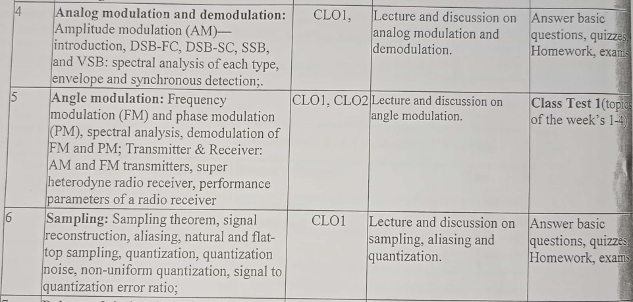
Week: 4-5

Slide 3
Phase Modulation

Slide 4
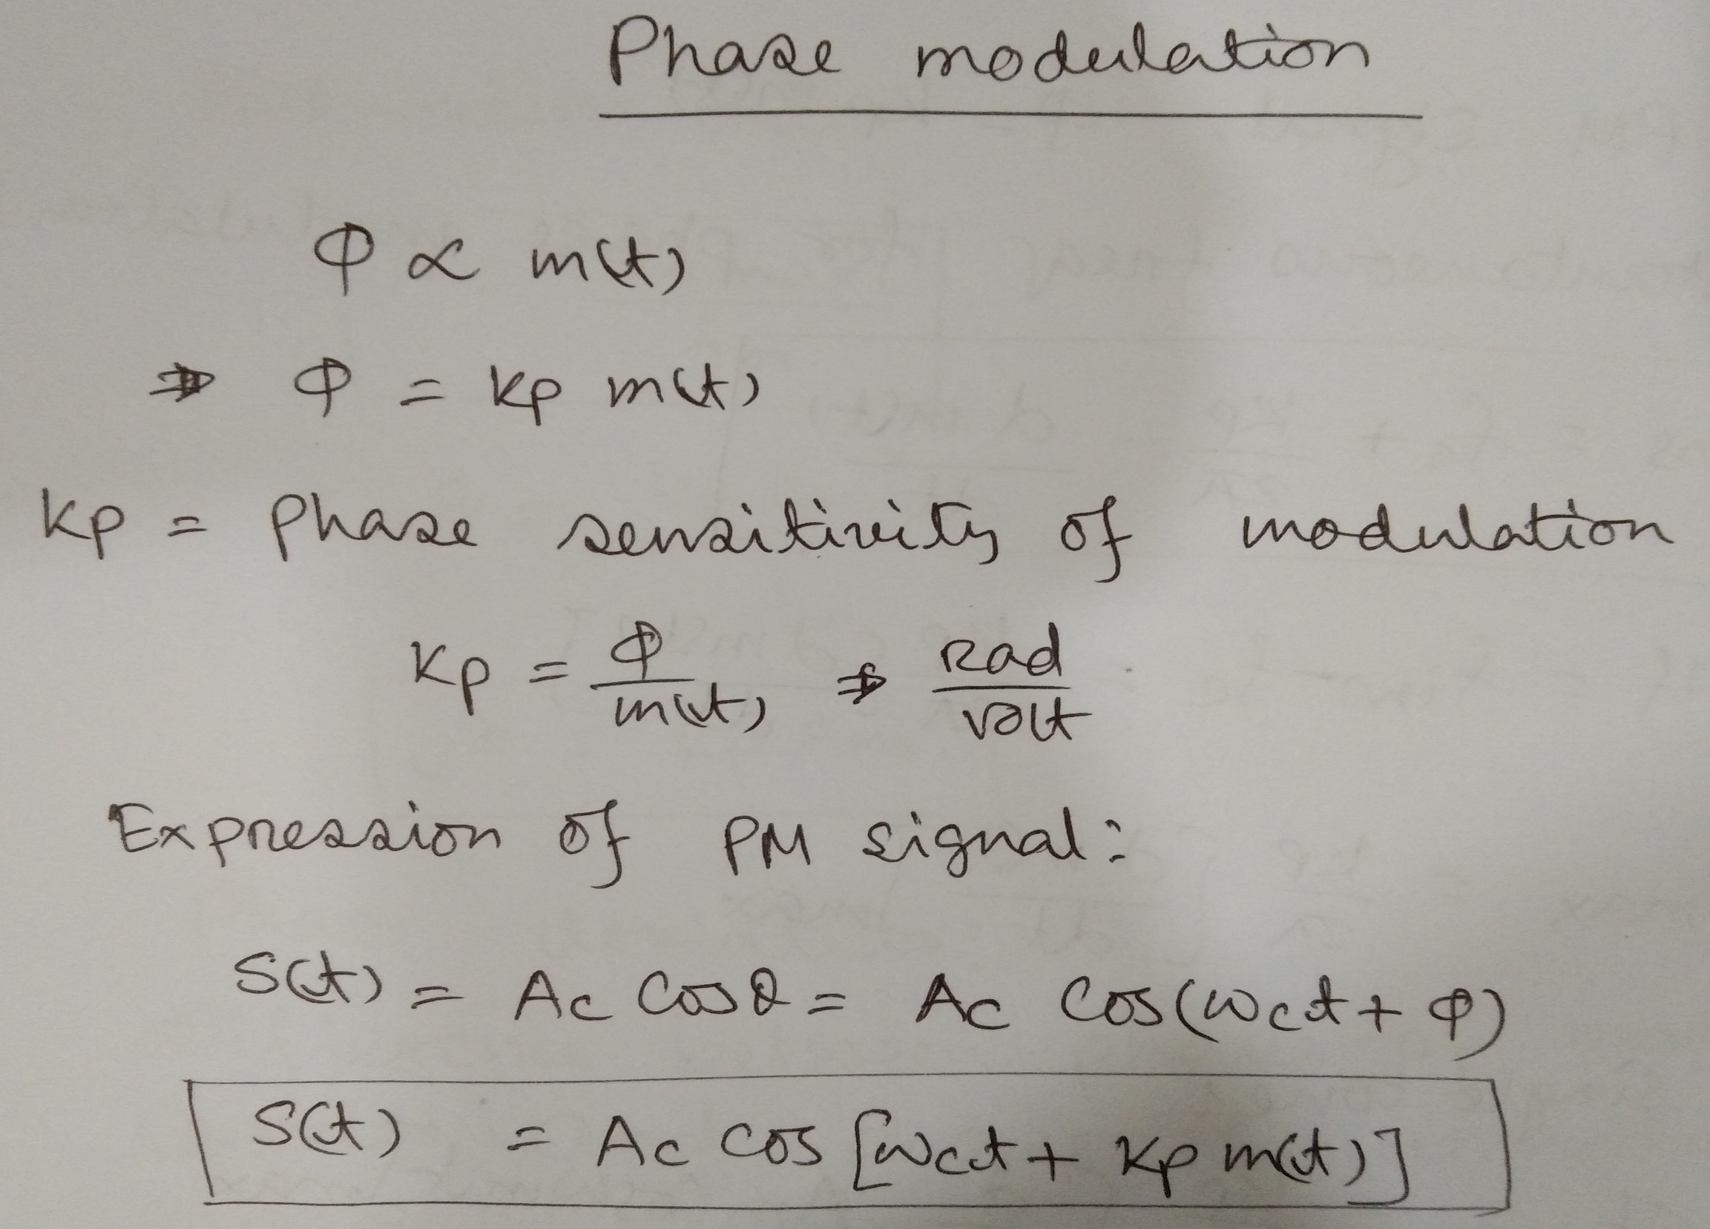

Slide 5
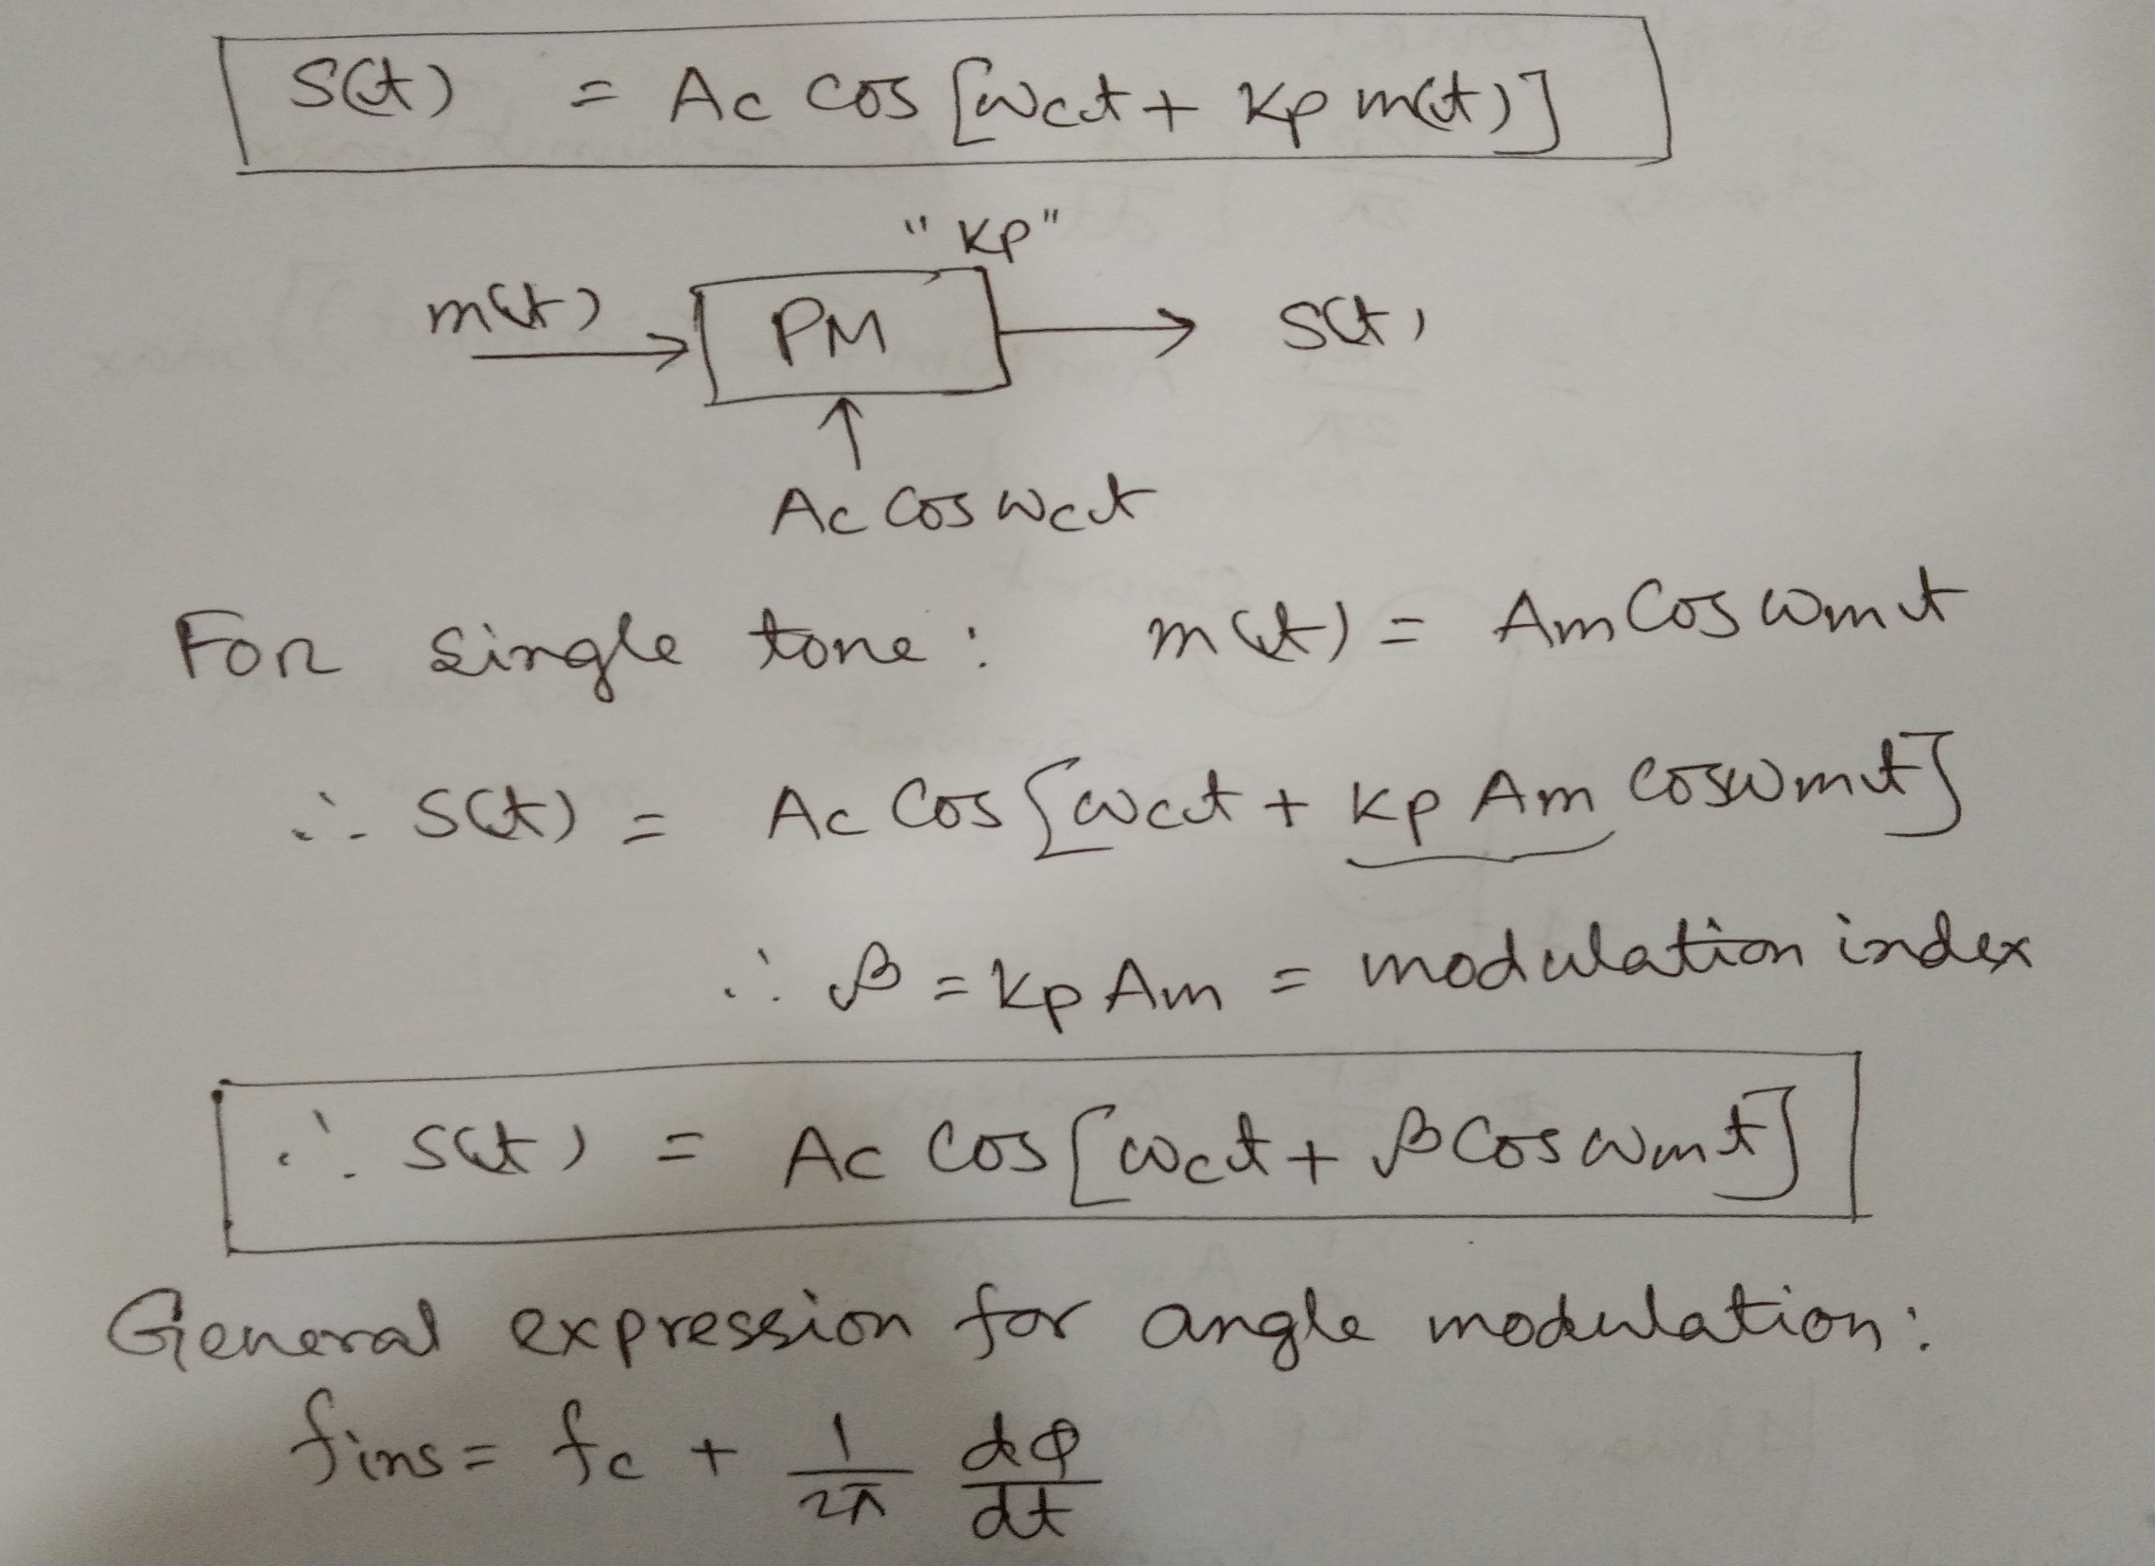

Slide 6
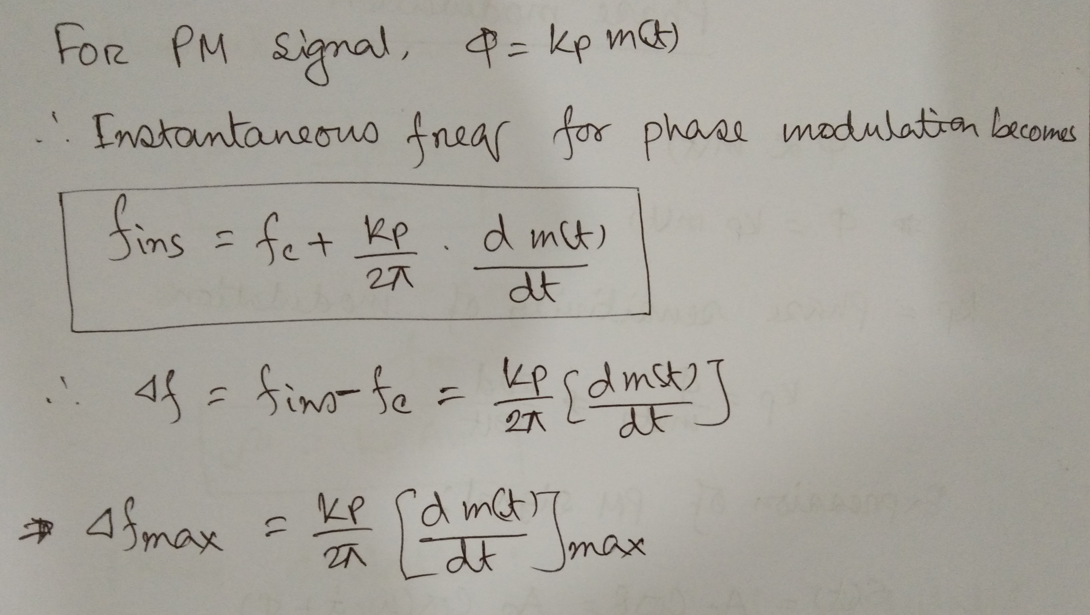

Slide 7
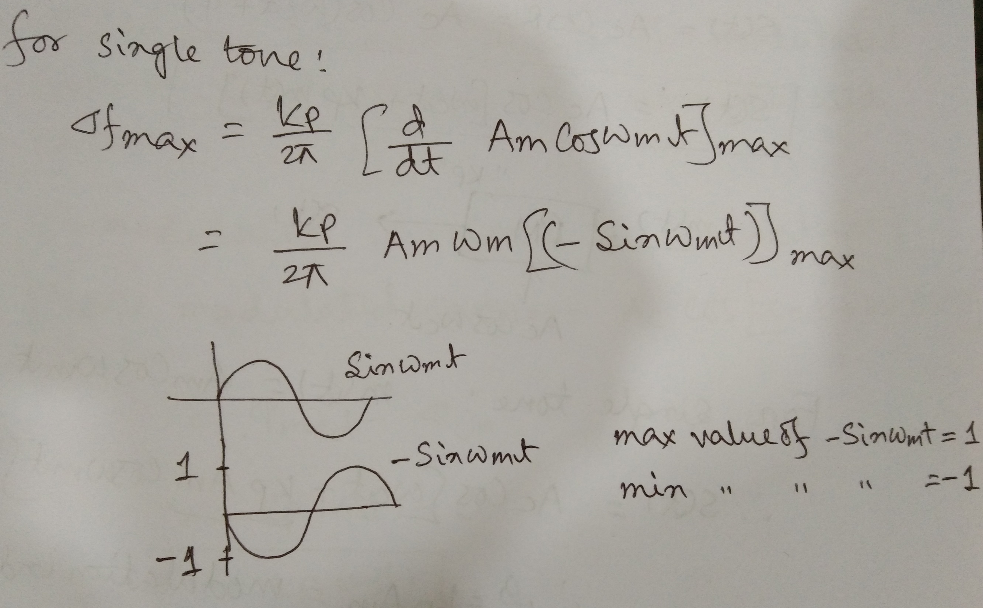

Slide 8
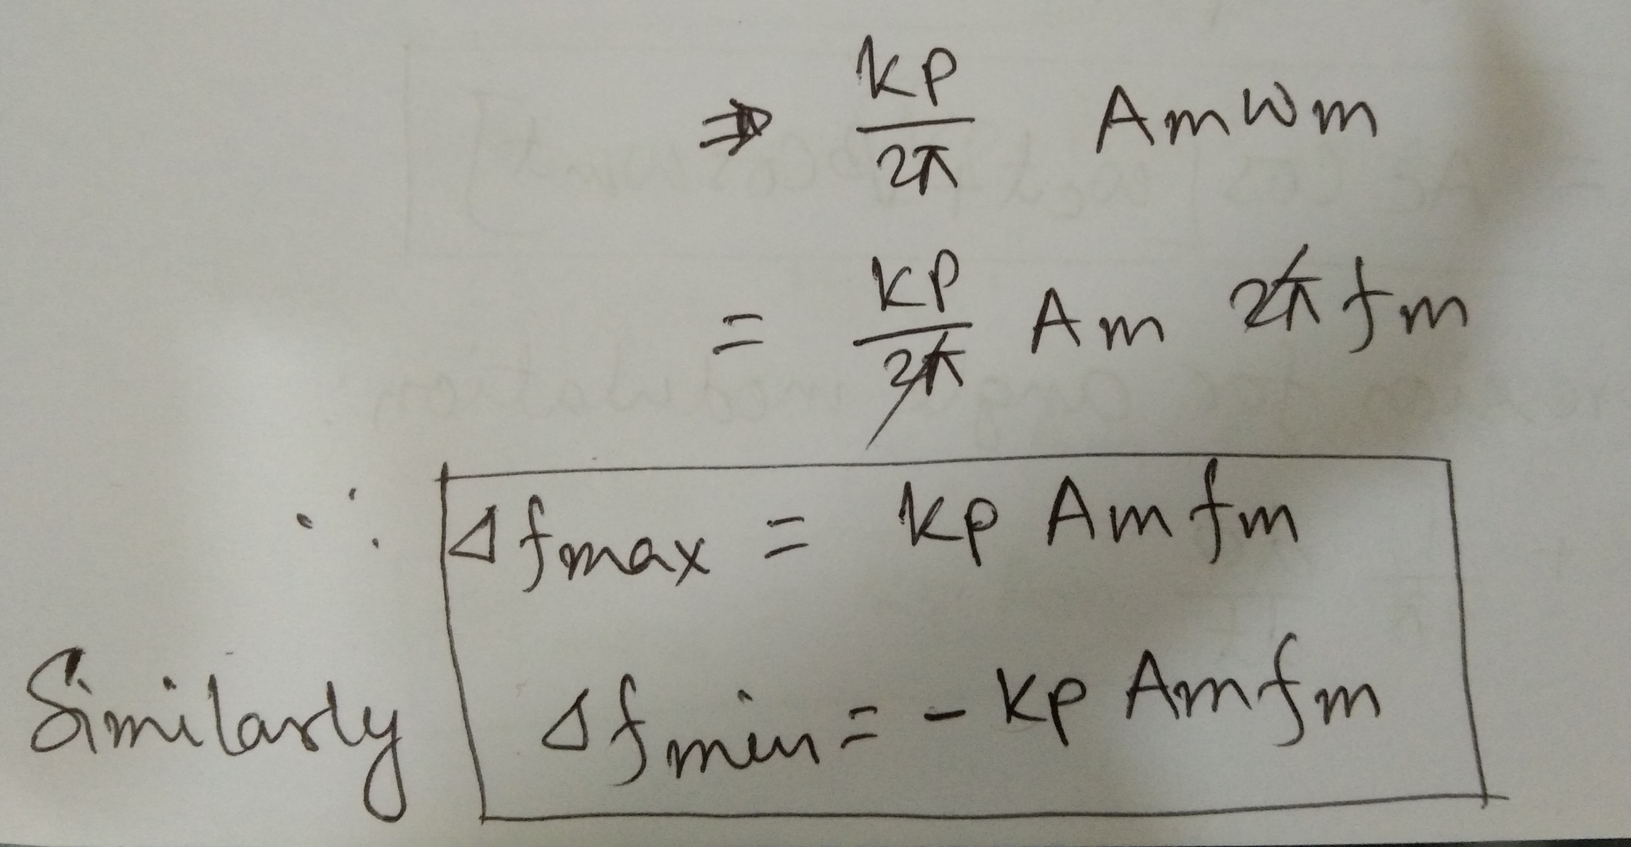

Slide 9
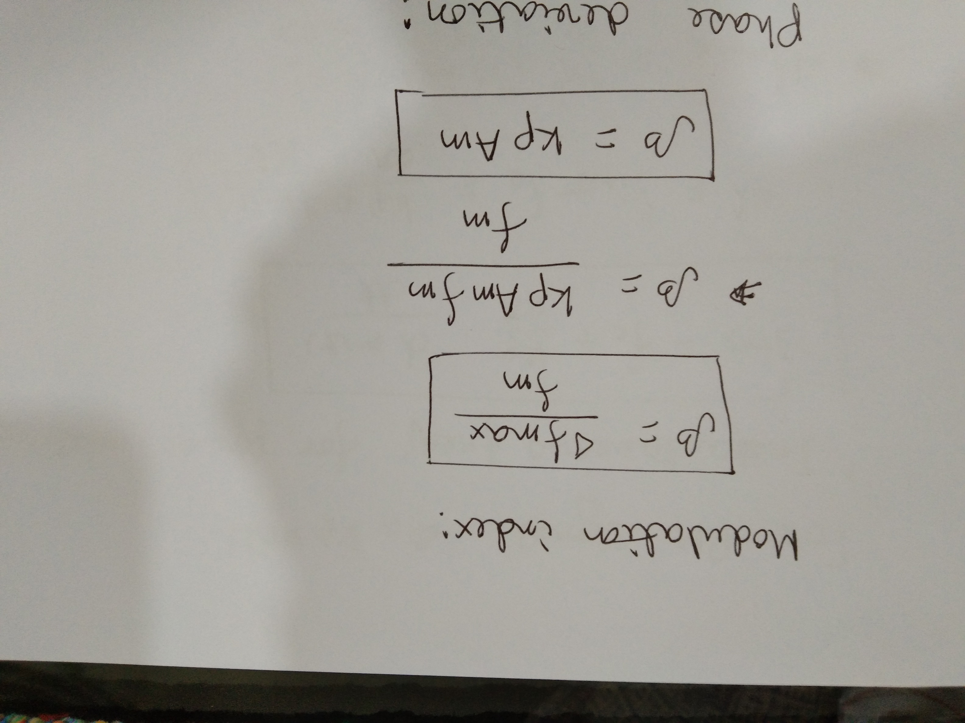

Slide 10
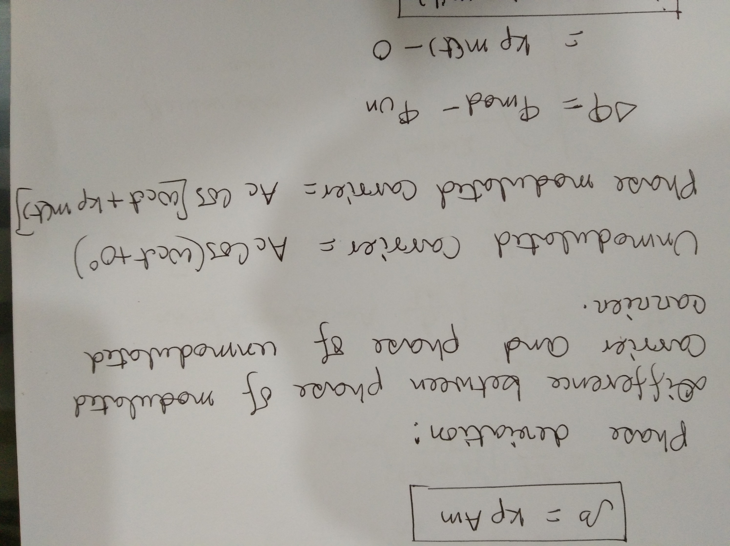

Slide 11
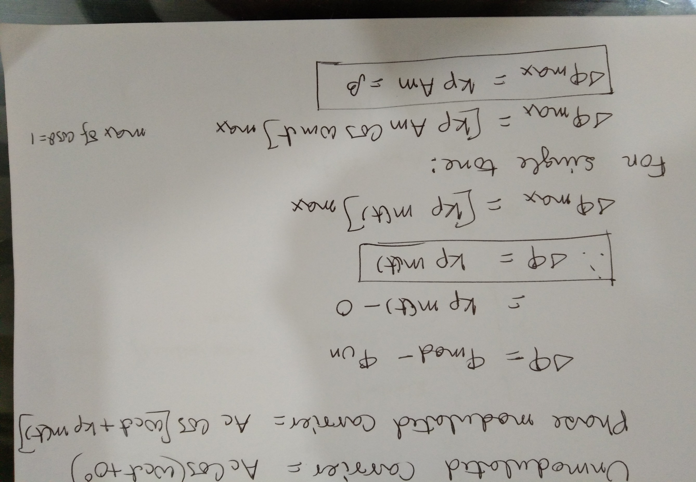

Slide 12
Time Domain Representation

Slide 13
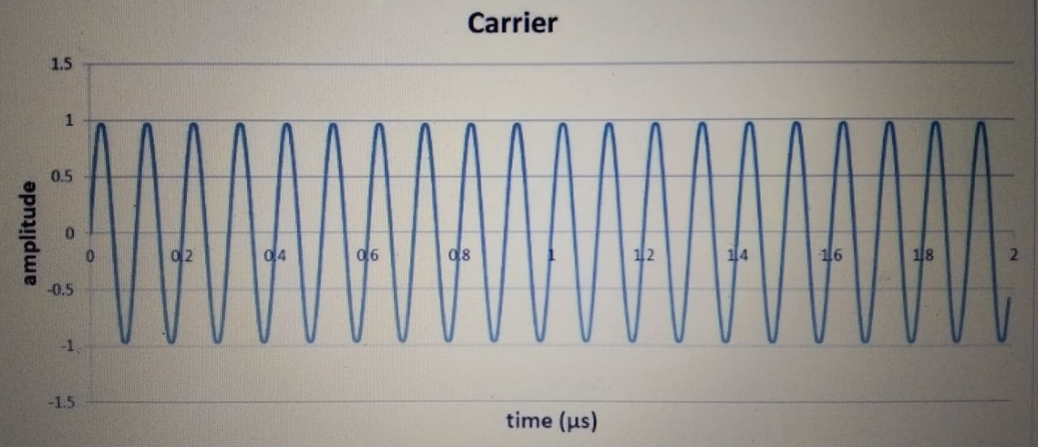
Carrier 10 MHz

Slide 14
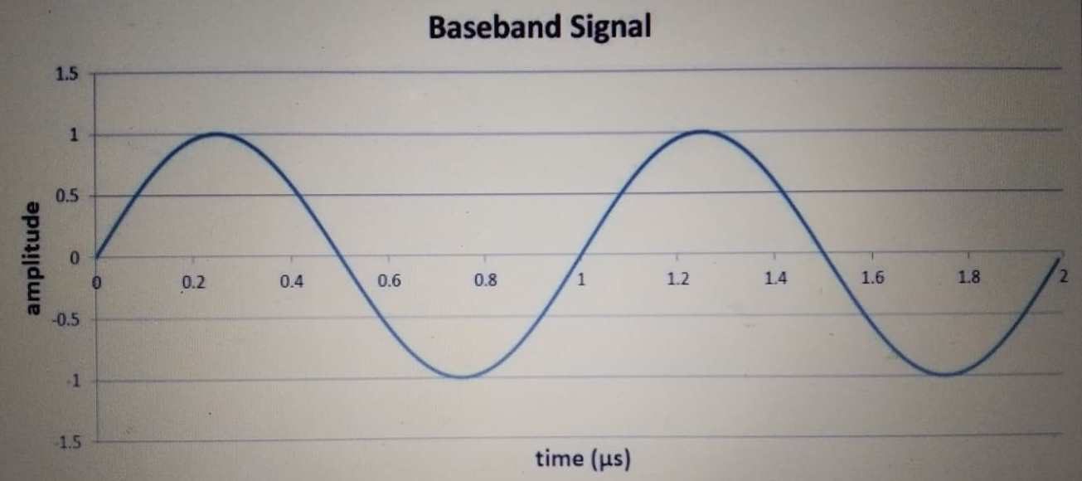
Baseband Signal 1MHz sine wave

Slide 15
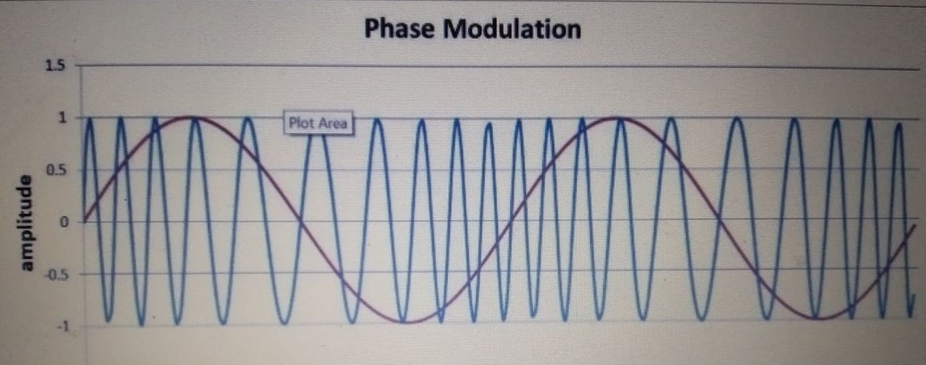
When m =1 (PM)

Slide 16
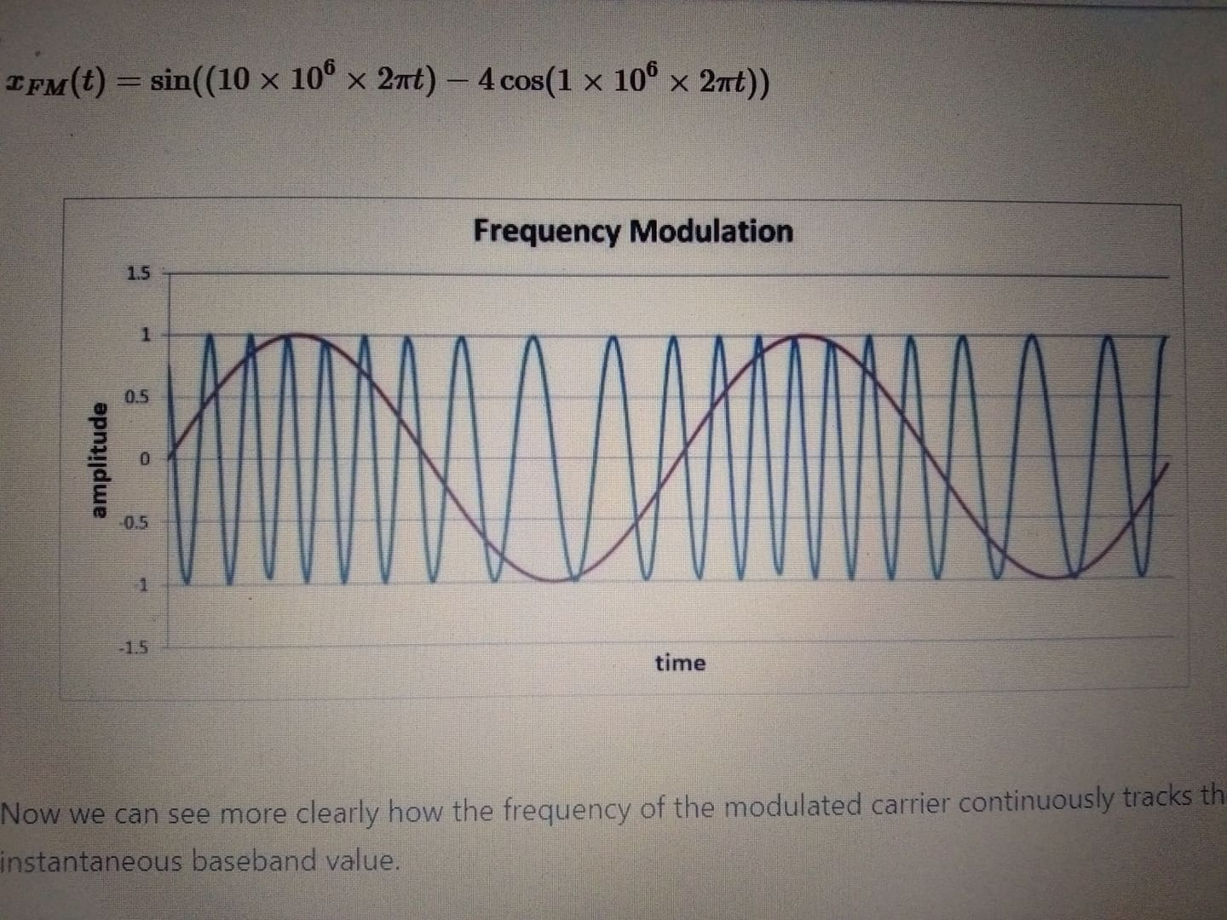
When m =4 (FM)

Slide 17
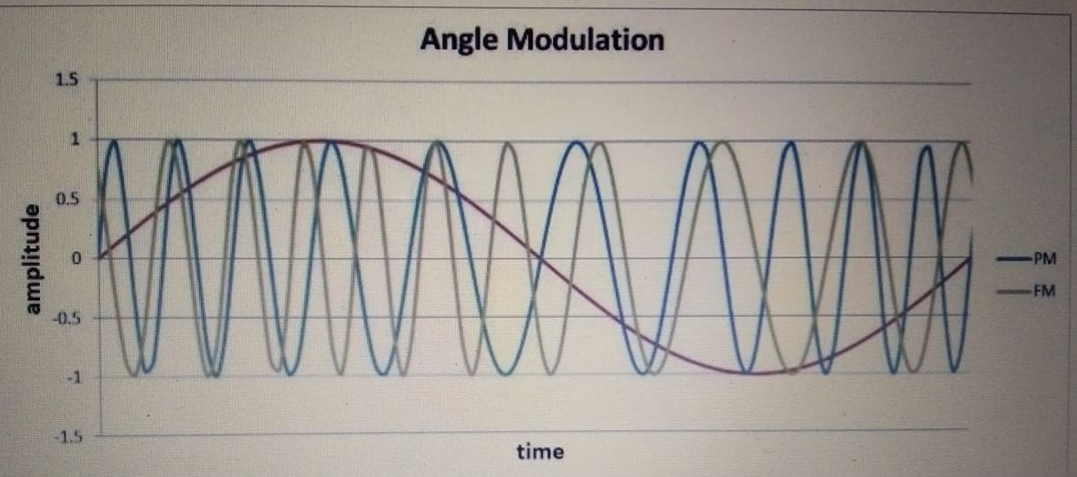
Comparative Graph when m =1 (wider time scale)

Slide 18
Spectrum Analysis

Slide 19
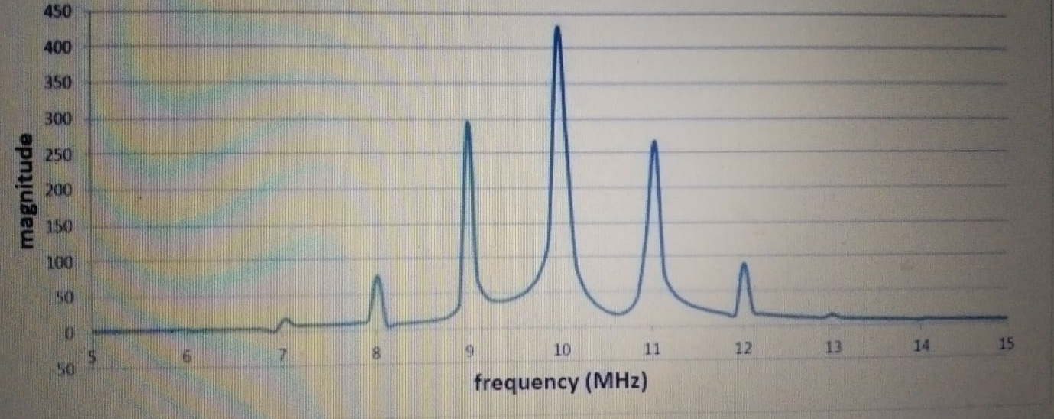
For m =1 for PM (same as FM)
It is the spectrum of the integral of the baseband signal that appears in the band surrounding the carrier frequency.

Slide 20
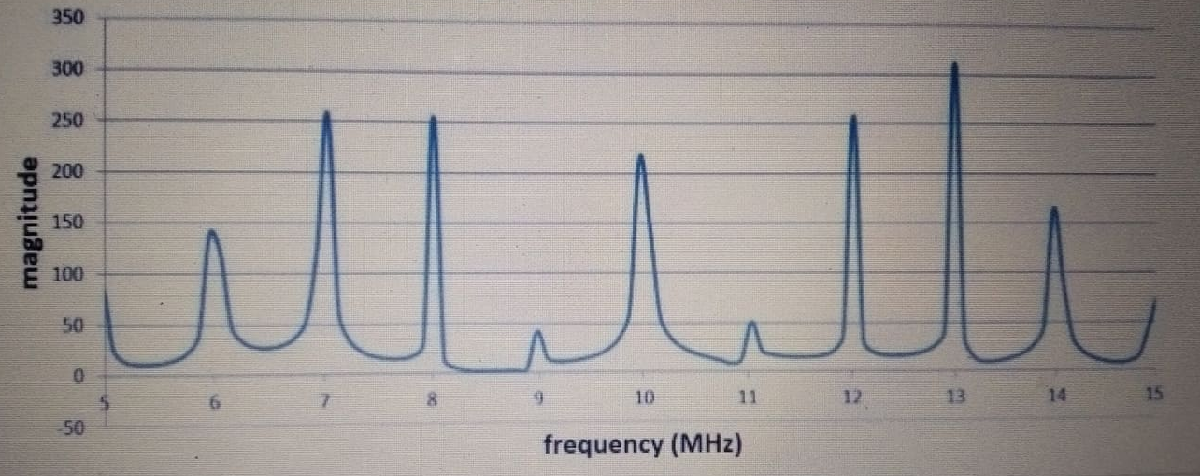
For m =4 for PM (same as FM)
It is the spectrum of the integral of the baseband signal that appears in the band surrounding the carrier frequency.

Slide 21
Summary
Phase modulation is calculated by adding the baseband signal to the argument of a sine or cosine function that represents the carrier.
The modulation index makes the phase variations more or less sensitive to the behavior of the baseband signal.
The frequency-domain effects of phase modulation are similar to those of frequency modulation.
Analog phase modulation is not common. However, digital phase modulation is widely used.

